Slide 1
Graphs with Key Insights
Xinglong, Yinyin, Himanshu

Slide 2
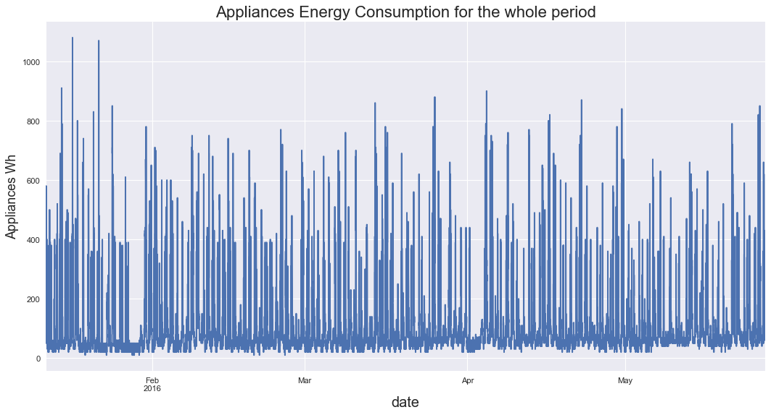
Fig. 1
The above plot shows the appliance consumption in Wh for the whole period from February and Jun 2016.

Slide 3

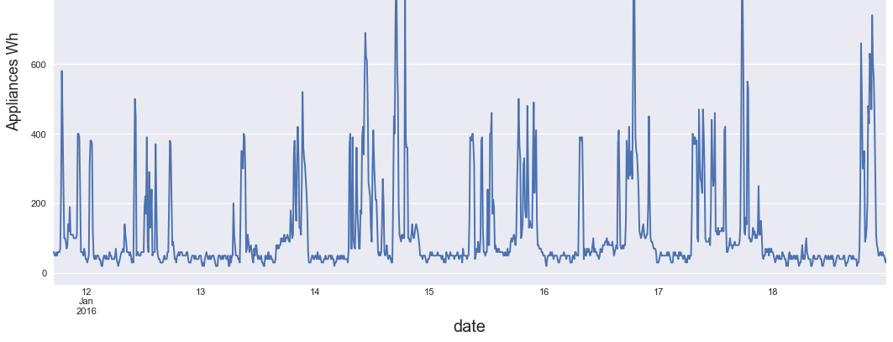
The Plot shows the Appliances consumption for the first week in February 2016.
Fig. 2

Slide 4
Key Insights from Fig. 1 and Fig. 2
The plots 1 & 2 shows marked peak in energy consumption during day.
The Plot 2 shows the average energy consumption is below the 50 Wh.
The plot 2 shows the average energy consumption is less than ¼ the peak energy consumption during the day.
The plot 2 shows high average consumption on Sunday marked by date 14th Feb., as approximated by the fact most the members of the family stays at home.

Slide 5
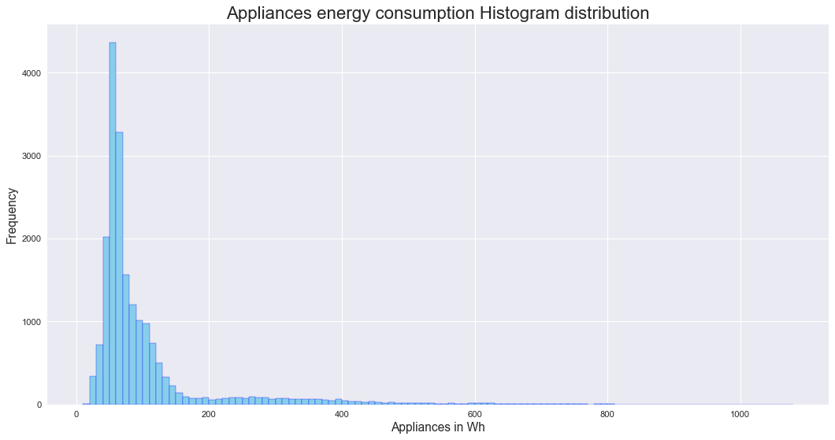
Fig. 3 The plot shows energy consumption over a period.

Slide 6
Key Insights:
The Fig. 3 shows the frequency of binned energy consumption over a period of six months.
The plot is skewed towards left and shows the frequency of energy consumption is high for 50 Wh which validates the findings in the plot 1 and plot2.

Slide 7
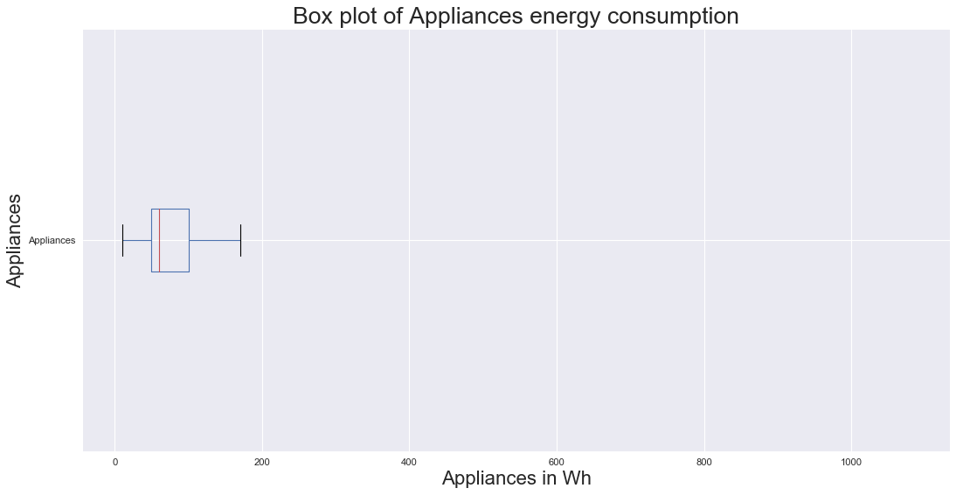
Boxplot between Energy consumption for Appliances over the period of six months
Fig. 4

Slide 8
Key Insights:
The Box plot shows the energy over the period of six months.
The maximum energy consumption is little less then 200Wh and minimum is more than zero.
Average consumption occurs approximately at 50 Wh.
The outliers shows the energy consumption has peaked many times in a day.

Slide 9
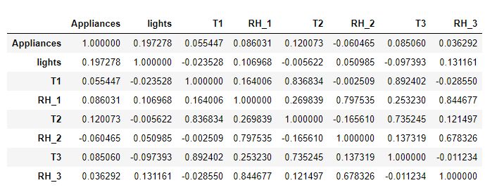
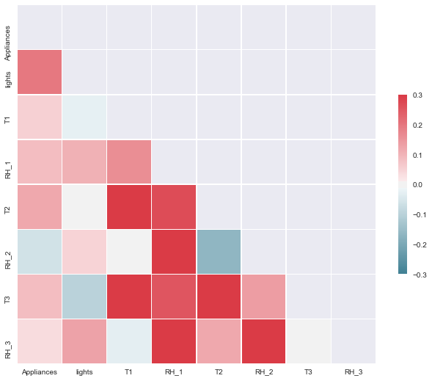
Fig.5
Plot shows the correlation for lights, Temperature, Relative Humidity at many places of the apartment.

Slide 10
Key Insights:
The correlation diag. shows the relationship of the energy consumption of various components of the house recorded over a period of six months.
The plot show the positive correlation between energy consumption of lights and Appliances.
Positive correlation is high i.e. 0.19 between indoor Temperature (T2) and Appliances energy consumption.
Positive correlation is expected between T1 and T3.

Slide 11
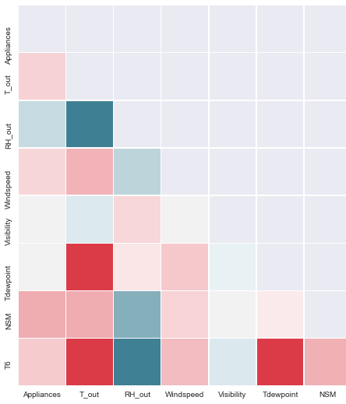
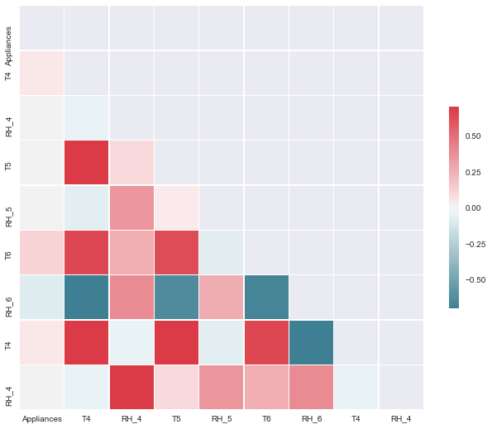
Fig. 6 ,7, 8
Fig. 6
Pairs plot showing relationships between the energy consumption of appliances with: T out, Pressure, RH out, Windspeed, Visibility, TDewpoint, NSM and T6.
Fig 7
Pairs plot showing relationships between the energy consump-tion of appliances with: T4, RH4, T5, RH5, T6, RH6. T4 and RH4
Fig 8
Pairs plot showing relationships between the energy consump-tion of appliances with: T7, RH7,T8, RH8, T9,RH9. T7 and RH7.

Slide 12
Key Insights:
Plot shows highest correlation between outdoor temperature and Appliances energy consumption.
Negative correlation exists between Appliances and outdoor humidity RH6.
positive correlations between the consumption of appliances and T7, T8 and T9 being 0.03, 0.05 and 0.02 respectively.
Highest correlation between the energy consumption of appliances and NSM with a value of 0.22.

